Slide 1
How to get the most out of visiting Iceland

Slide 2
Background
People would do this when managing their time when traveling to Iceland.
This tutorial is useful because people will get more out of their visit, save money and save time.

Slide 3
Design objectives & strategy
The goal of the design is to is to make it easy for people to use
…show people how to plan their trip to Iceland
…make the tours easier to find what they are looking for

Slide 4
Site audience
This tutorial site will help people who aren’t used to traveling and planning their trips

Slide 5
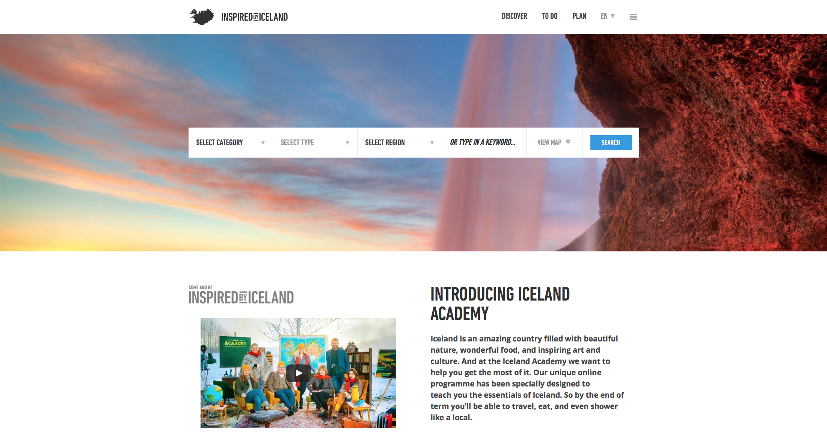
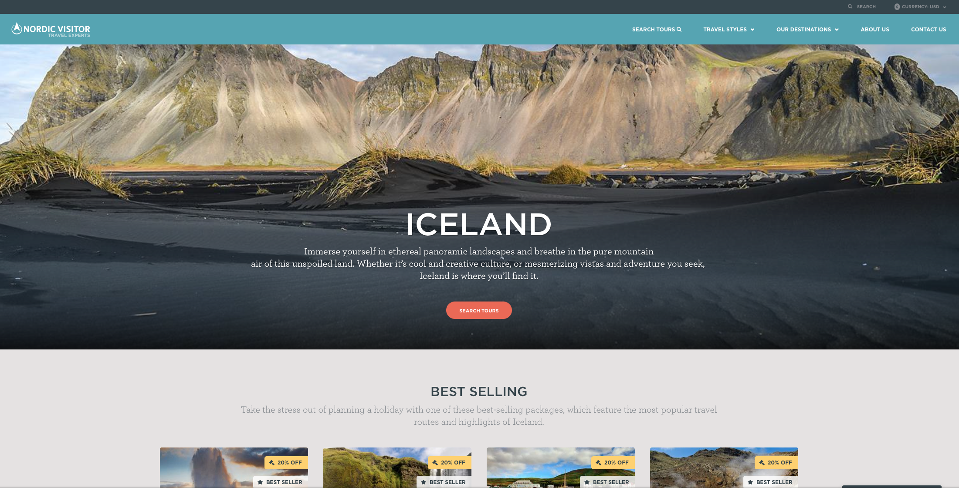
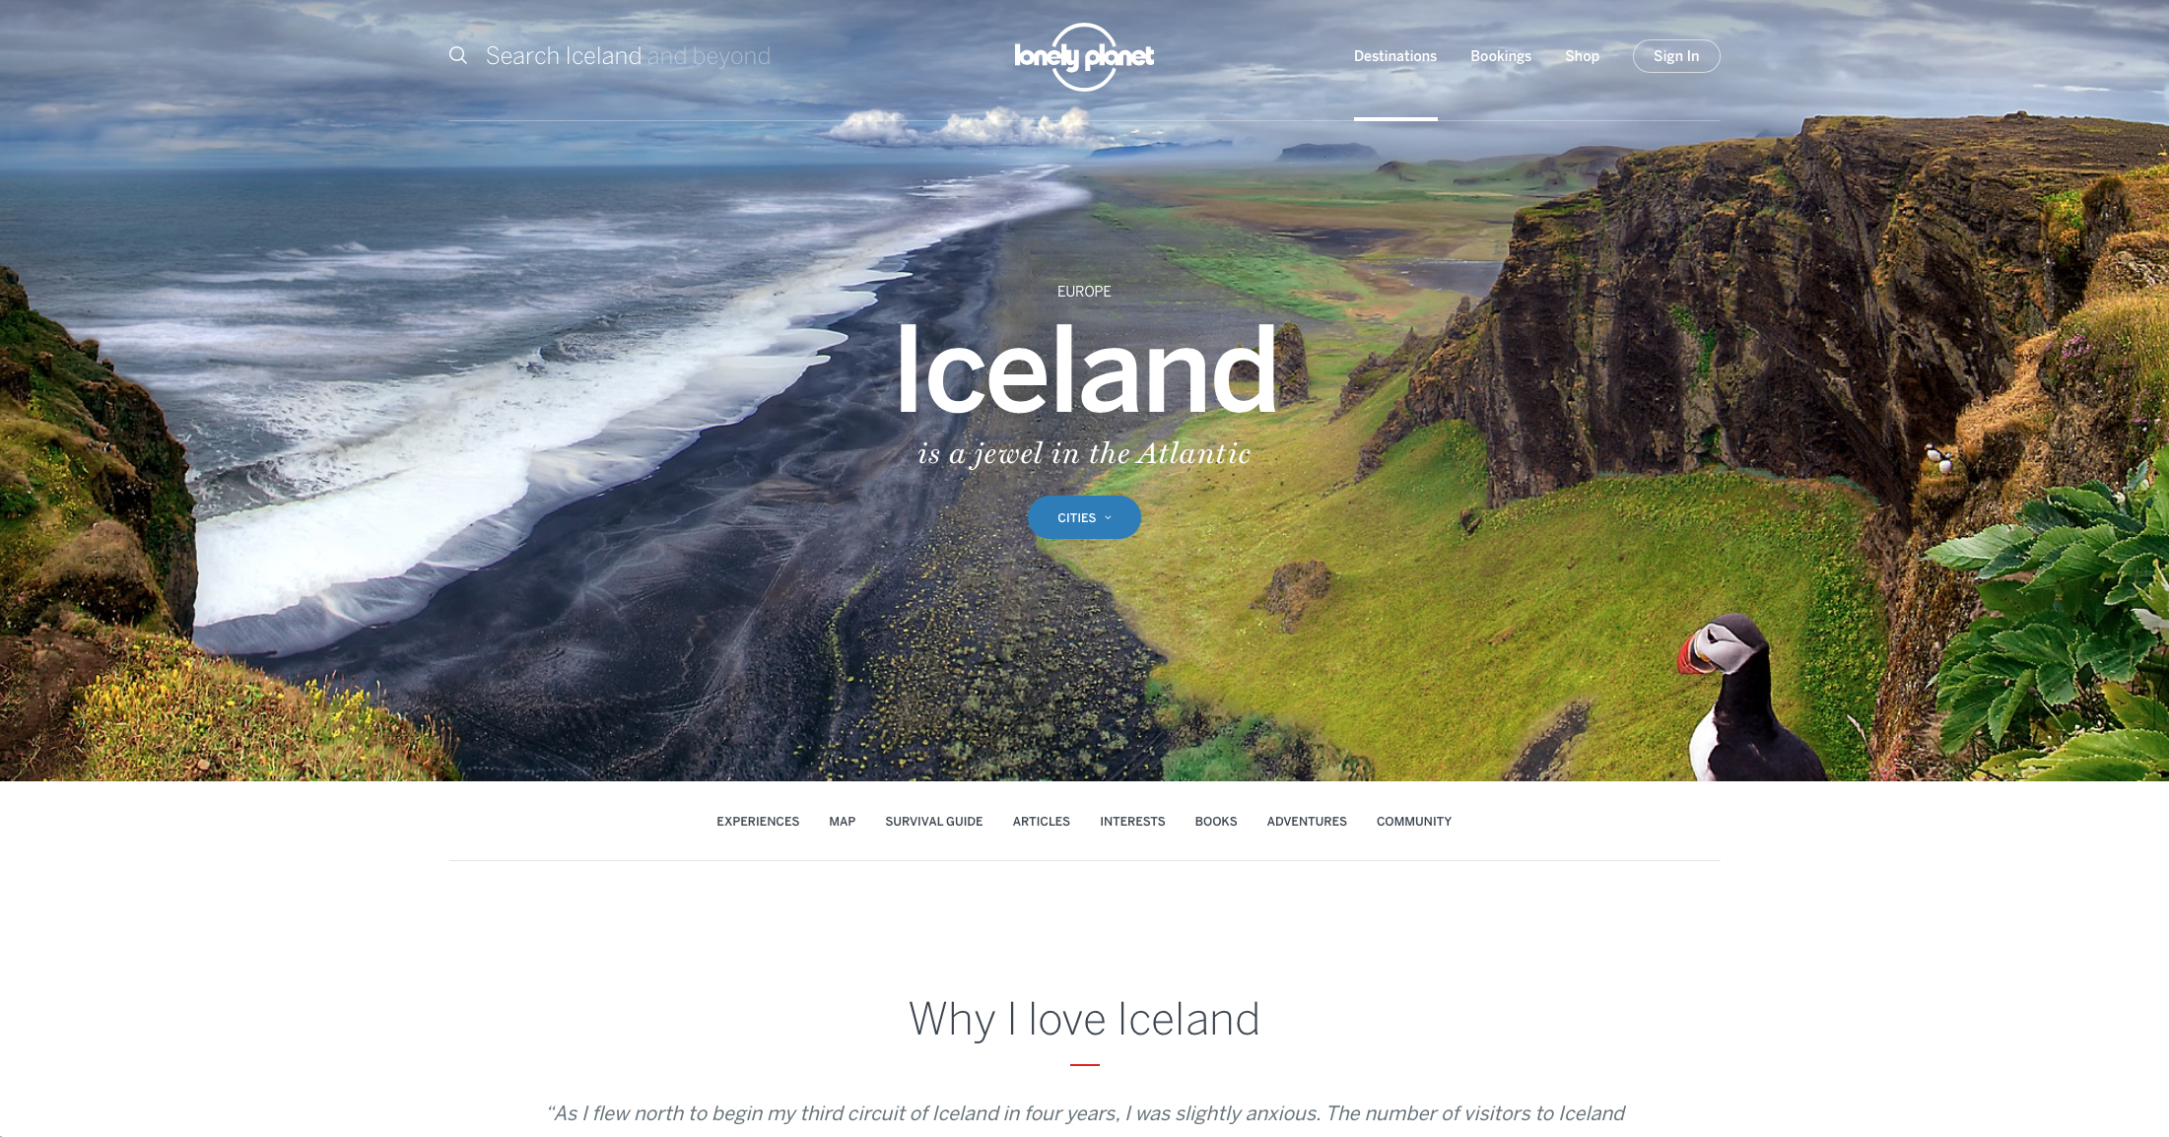
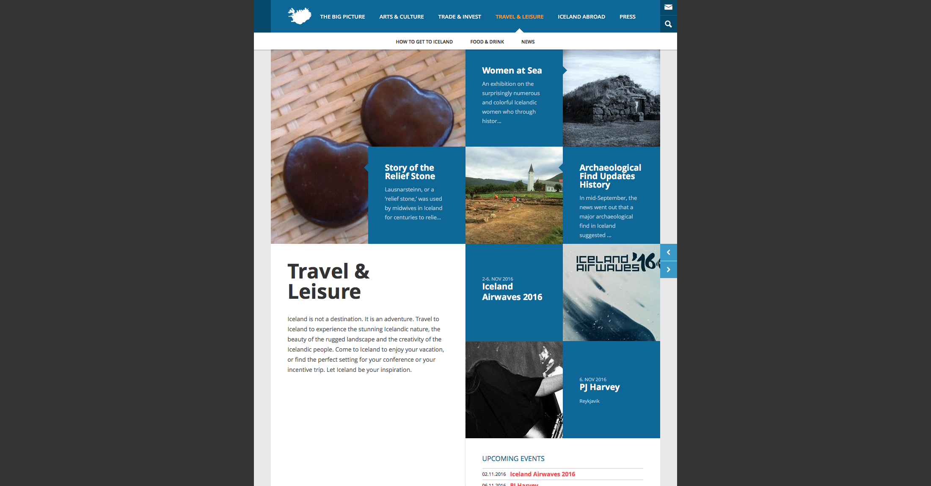
Competitors

Slide 6
Colors and textures

Slide 7
Keywords
Site should be
Site shouldn’t be
Easy
Welcoming
Clean
Informing
Dark
Formal
Clean…

Slide 8
Content for the site
The site should include content like…
Photos
Videos
Places to go
Ratings
Things to see
People to meet

